Slide 1
Labor After the Civil War

Slide 2
Population and Labor Force (in Millions), 1870–1920
Population is increasing, as is immigration. The labor force is also increasing faster than population up until WWI. Most of this labor is not working in agriculture.

Slide 3
Why is population increasing?
Birthrate or fertility is declining for blacks and whites.
Death rates are declining faster. (Increase in life expectancy)
Why?

Slide 4
Decline in Birthrates
Economics of family-cost vs benefits
Factors that increase cost-
  Compulsory schooling laws
Factors the reduce benefit
  Urbanization limits the contribution of children to family income (children work on farms earlier)
  Land and machinery become more important than labor
Increase in income changes preferences for children.
  Quality vs quantity

Slide 5
Decline in Death rates
Better public health measures
  Improved sanitation and sewage disposal
  Improved water supplies
    Chlorination, piped water systems.

Slide 6
U.S. Immigration and Business Cycles, 1865–1914
Immigration increases when income is high and goes down during recessions.
Where do people come from?

Slide 7
Origins of Immigrants, 1820–1920 (in Percent)
More immigrants come from central, eastern and southern Europe after 1890. Reflects rising incomes in Western Europe and lack of economic opportunity and political unrest in other parts of Europe.
As before immigrants tend to be unskilled labor. When education and schools are taken into account there is not much evidence of discrimination in the labor market.

Slide 8
What happens to wages?
Real Earnings of Nonfarm Employees
Series differ because the first does not account for unemployment. Notice the upward trend continues after 1890.
Consistent with increases in demand for labor being larger than supply.
However, this does not mean all types of labor had equal gains.

Slide 9
Did immigrants effect income of US born workers?
US born unskilled workers saw immigrants as a substitute and cause of wages not rising as fast as they could have.
US skilled workers saw unskilled workers as potential substitutes, reducing the demand for skilled labor.
Both opposed immigration.

Slide 10
Other gains made by labor
Drop in hours worked per day and days worked per week.
Reduction of child labor.
  State regulation
  Increase in compulsory schooling laws

Slide 11
Unions
As firms grew in size, workers organized to form unions to bargain more effectively for higher wages and better working conditions.
Union is basically a cartel where the members are workers rather than firms selling a product.
To be effective all workers in the industry have to be members. Because of the incentive to free ride, they will not join unless legally compelled to do so.

Slide 12
Unions
Firms opposed unionization both in the courts and at the firm level
Violence on both sides was common during the early part of the movement.
Were unions responsible for labors gains during this period?

Slide 13
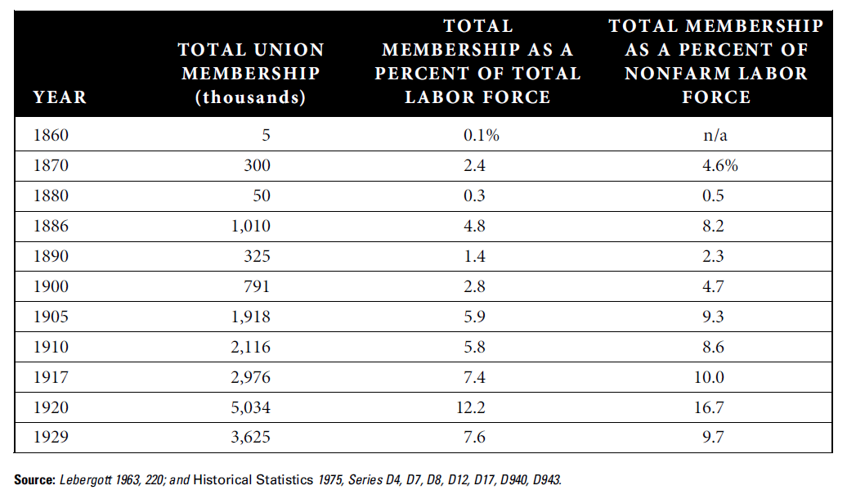
Union Membership, Selected Years
Union membership is small during this period. Probably more effective at lobbying to change state laws to restrict length of working day and child labor.

